Slide 1

Chapter 4
System Software
Computing Essentials 2023
O’Leary
Notes:
The chapter introduces you to how to protect your computer and data today and prepare you for tomorrow including mobile operating systems, desktop operating systems, and utilities.

Slide 2
Learning Objectives
Describe the differences between system software and application software.
Identify the four types of system software programs.
Explain the basic functions, features, and categories of operating systems.
Compare mobile operating systems iOS, Android, and Windows 10 Mobile.
Compare desktop operating systems, including Windows, MacOS, UNIX, Linux, and virtualization.
Explain the purpose of utilities and utility suites.
Identify the six most essential utilities.
Notes:
Review the Learning Objectives with students to help them understand what they need to get from the chapter.

Slide 3

Introduction
Computers and computer applications have become a part of the fabric of everyday life
They are great as long as they are working.
We give little thought to the processes and programs running behind the scenes to keep them functioning effectively.
Such programs (that is, operating systems, utility programs, and device drivers) are the system software you learn about here.
Notes:
Explore the process that work behind the scenes to make up the technology we depend on today.

Slide 4
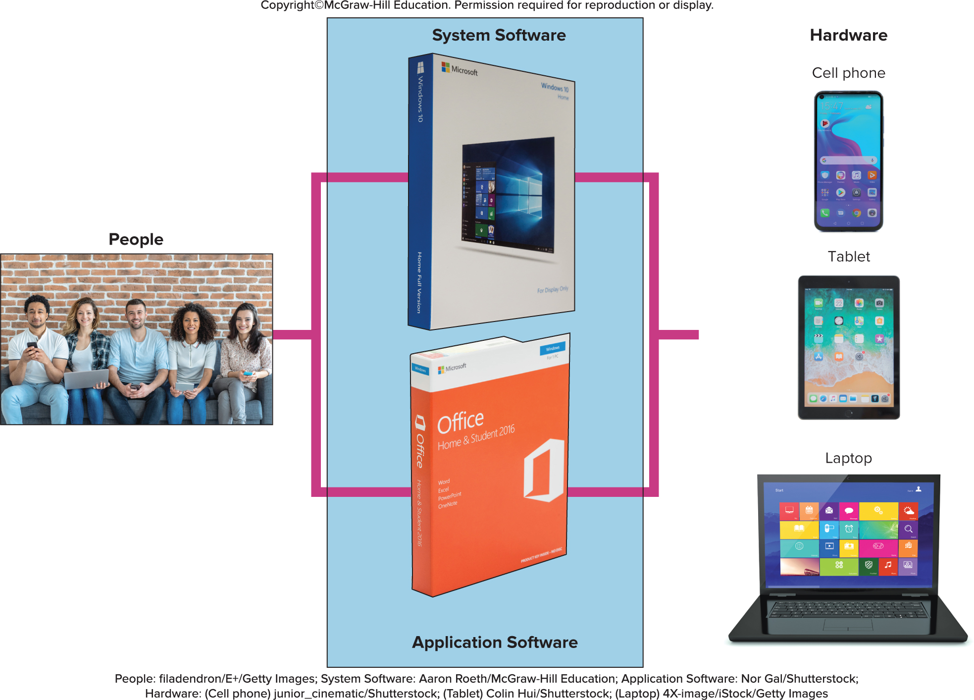
System Software Basics
Works with end users application software, and computer hardware
Handles the technical details.
Includes.
Operating systems.
Utilities.
Device drivers.
Language translators.
Access the text alternative for slide images.
Iladendron/E=/Getty Images; Aaron Roeth/McGraw-Hill Education; Nor Gal/Shutterstock; junior_cinematic/Shutterstock; Colin Hui/Shutterstock; 4x-image/istock/Getty Imges
Notes:
System software (key term) is not a single program but is a collection of programs that handles hundreds of technical details with little or no user intervention
End-users focus on application programs more than the system software, but it is important to understand how system software works
Four types of programs:
Operating systems (key term) coordinate computer resources
Utilities (key term) perform tasks related to managing the computer resources
Device drivers (key term) programs that allow devices to communicate with the computer system
Language translators (key term) converts programming instructions into a language the computers understand

Slide 5
Operating Systems
A collection of programs that handle technical tasks
Functions:
Manages resources.
Providing user interface.
User interface.
Graphical user interface (G U I).
Runs applications.
Multitasking.
Foreground and background applications.
Notes:
Operating systems (key term) collection of programs that handle technical tasks
Functions –
Managing resources – OS coordinates all computer’s resources
Providing user interface – OS allows users to interact with application programs and computer hardware
User interface (key term) and graphical user interface or GUI (key term)
Running applications
Multitasking (key term) – the ability to switch between applications
Foreground (key term) – the program you are currently working on
Background (key term) – the other programs that are running but not the active window

Slide 6
Features of an Operating System
Features in common with application software
Icons.
Pointer.
Windows.
Menus.
Tabs.
Dialog boxes.
Help.
Gesture Control.
Features
Booting – starting or restarting the computer.
Files and Folders
Files share data and programs.
Folders store related files.
Notes:
Common features in application software:
Icons are graphic representations of programs
Pointer is controlled by mouse, trackpad, or touch screen
Windows are rectangular areas on the screen
Menus provide a list of options or commands
Tabs divide menus into activity areas
Dialog boxes display information or request input
Help provides online assistance
Gesture Control (key term) is the ability to control operations with finger movements: i.e. swiping, sliding and pinching
Booting (key term) is the process of starting a computer
Warm boot (Key Term) – computer is already on and you restart it without turning off the power
Cold boot (Key Term) – starting a computer that has been turned off
Most operating systems store data and programs in system files (key term) and folders (key term)
Files and folders
Files share data and programs
Folders store related files

Slide 7
Categories of Operating Systems
Embedded Operating Systems – R T O S
Stand-alone Operating Systems
Network Operating Systems
Notes:
Three basic categories of operating systems:
Embedded OS (key term) – used for handheld devices - RTOS – real-time operating system
Smartphones
Smartwatches
Video game systems
Stand-alone (key term) – or desktop operating systems (key term) – control a single desktop computer
Also called desktop operating system
Network operating systems (NOS) (key term) – control and coordinate networked computers. OS is stored on the network server (key term)
Windows Server, Linux, Unix
OS stored on network server which coordinates all communication between the other computers
Operating system is often referred to as the software environment (key term) or software platform (key term) almost all OS’ are designed to run only on specific platforms

Slide 8
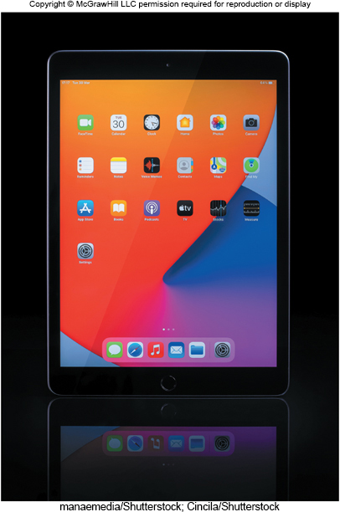
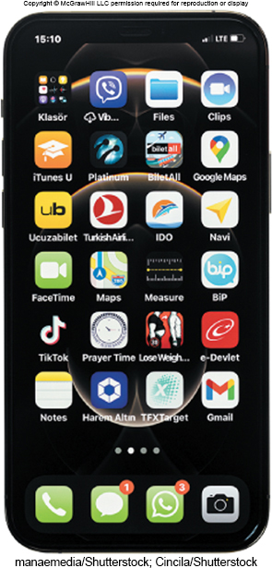
Mobile Operating Systems
Embedded operating system
Less complicated and more specialized for wireless.
Popular
Android.
i O S.
Beer5020/Shutterstock; Alexey Boldin/Shutterstock
Notes:
Mobile operating systems (key term) also known as mobile OS (key term) are embedded OS that are less complicated and more specialized for wireless technology
Android (Key term) – owned by Google
iOS (key term) - formerly iPhone OS (key term) , iPad and iPhone

Slide 9
Desktop Operating Systems
Operating systems commonly used by individuals
Windows – most widely used.
Mac O S – powerful and easy to use, runs only on Apple computers.
UNIX – network; originally designed for Web.
LINUX – non proprietary; open source program, free to distribute and modify.

Slide 10
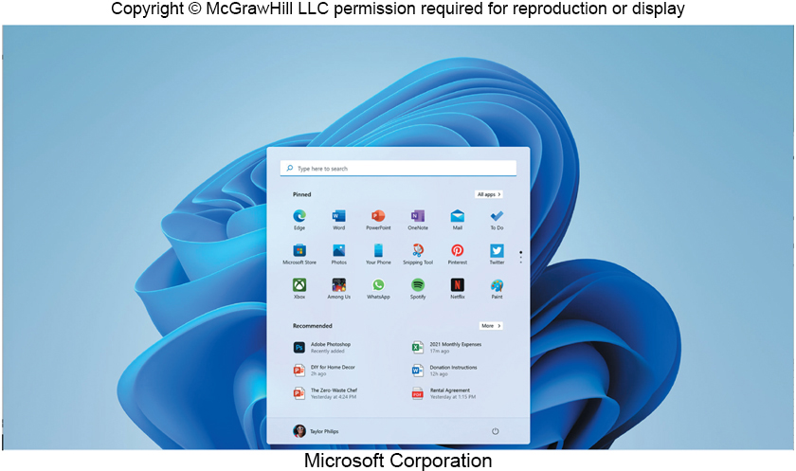
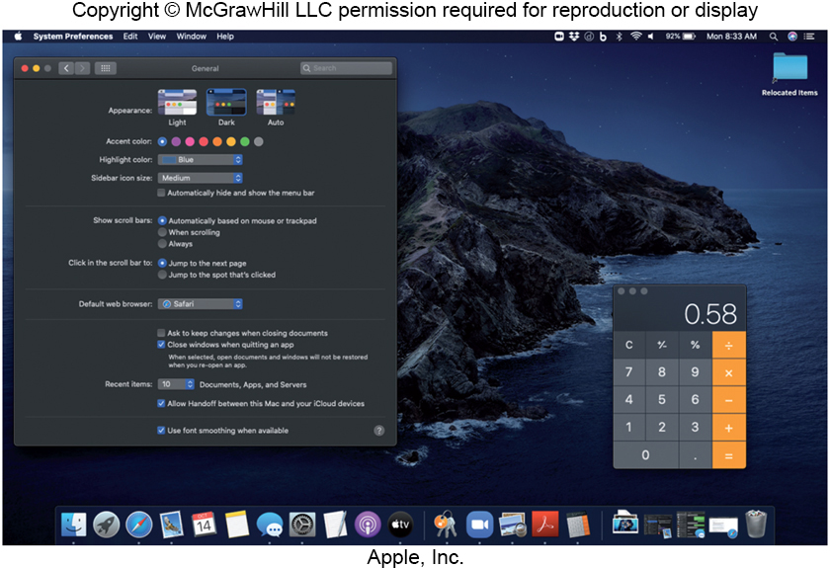
Windows - mac
Windows 11
Simplified interface and improved support for mobile devices.
Allows Android apps on Windows device.
macOS
Runs only on Apple computers.
Most innovative operating system.
Microsoft Corporation; Apple
Notes:
Windows (key term) most widely used personal computer operating system
announced in 2021
runs on desktop, laptop, tablet
Improved support for mobile devices including tablets and 2 in 1 laptops
ability to run Android apps on a Windows device
macOS – (key term) designed to run only with Apply computers.
most widely used Mac desktop operating system.
macOS Monterey
announced in 2021
includes ability to control multiple devices from one keyboard and mouse
Improved videoconferencing tools

Slide 11
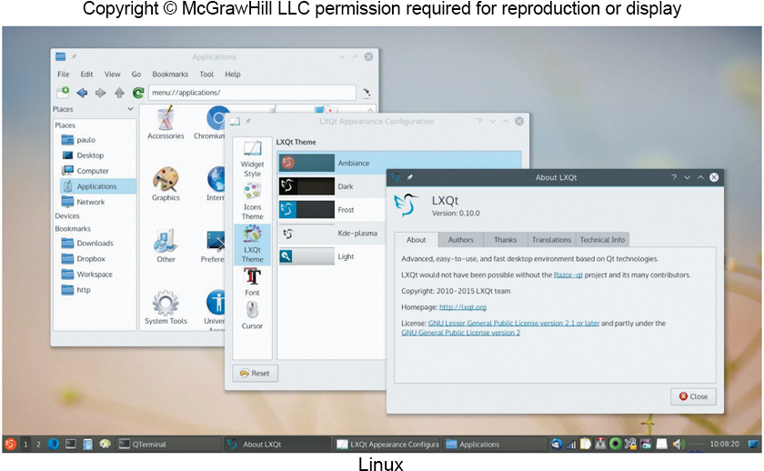
UNIX and LINUX
UNIX operating system
Servers on the Web.
Mainframe computers.
Personal Computers.
LINUX - version of UNIX.
Alternative to windows.
Open source – free.
Google Chrome O S and Android are based on Linux.
Focuses on Internet connectivity and cloud computing.
Speed is determined by the speed of the Internet.
Notes:
UNIX (key term) – originally designed in the late 1960s to run on minicomputers but now is used in network environments
Used by powerful personal computers and by servers on the Web
There are numerous versions of UNIX
LINUX (key term)– operating system that extended one of the versions of UNIX. Developed in 1991
Free distribution of the operating system code – Open source (key term)
Google’s Chrome OS (key term) and the Android mobile operating system are based on Linux

Slide 12
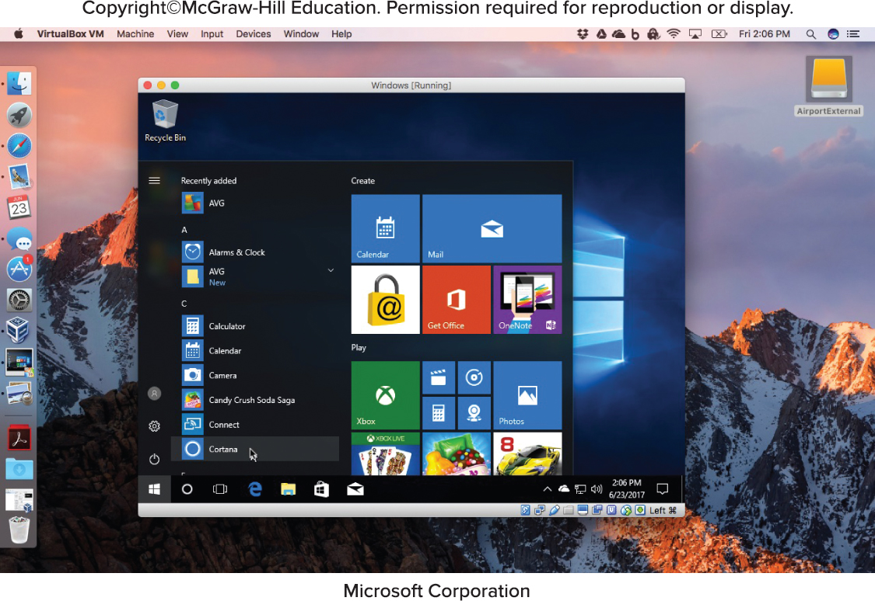
Virtualization
Ability to support multiple operating systems on a single physical machine
Virtualization software
Each virtual machine appears as a separate independent computer.
Host operating system.
Guest operating system.
Parallels and VMware
Programs that allow Mac to run Windows programs in macOS.
Microsoft Corporation
Notes:
Virtualization (key term) – supporting multiple OS that operate independently by running virtualization software (key term)
Each OS is known as a virtual machine (key term)
Host operating system (key term) - OS of the physical machine
Guest operating system (key term) - OS of virtual machine
Parallels and VMware are examples of virtual software programs that allow a user on a Mac computer to run Windows programs in macOS

Slide 13
Most Essential Utilities
Search Programs.
Storage Management Programs.
Backup Programs.
Antivirus Programs.
Troubleshooting Programs.
Virtual Assistants.
Notes:
Utilities (key term) – specialized programs designed to make computing easier
Search program (key term) provides a quick and easy way to search or examine an entire computer system
Storage management program (key term) helps solve the problem of running out of storage space by listing files or programs that could be eliminated
Backup program (key term) makes copies of files to restore if the originals are damaged
Antivirus program (key term) guard your computer against viruses
Troubleshooting program (key term) or diagnostic program (key term) recognize and correct problems
Virtual Assistants (key term) utilities that accept commands through text or speech to allow intuitive interaction with your computer, cell phone, or tablet across multiple applications

Slide 14
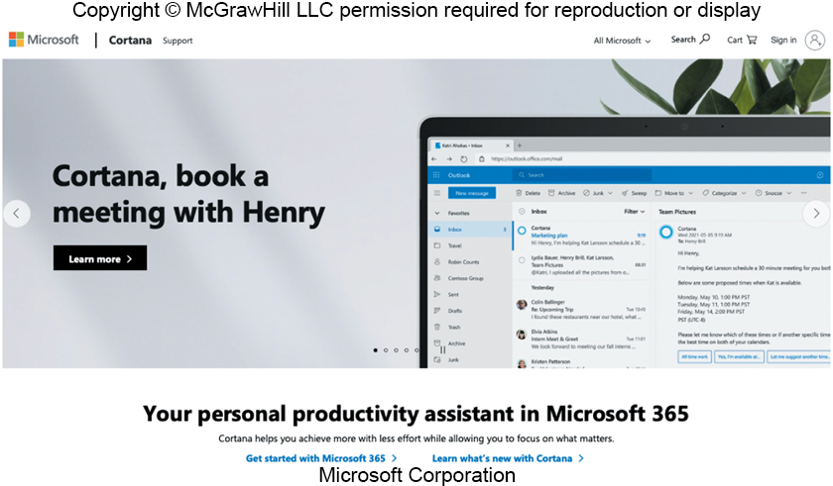
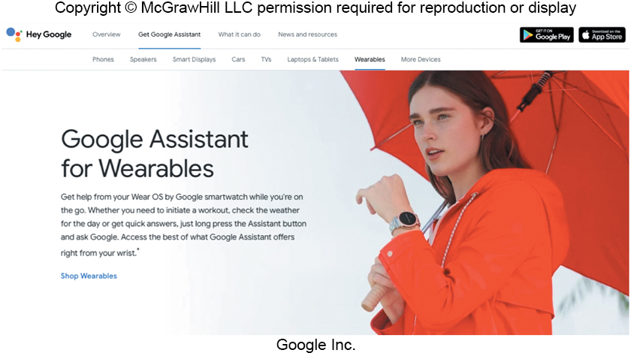
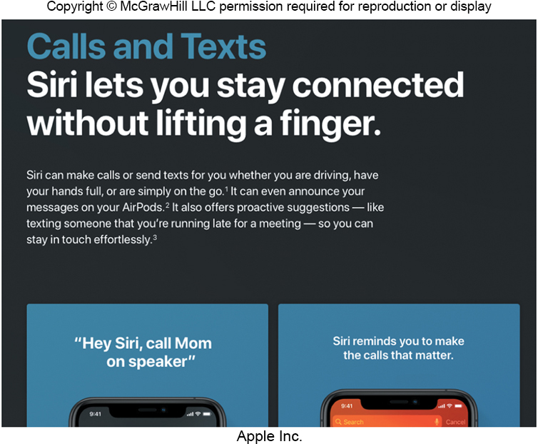
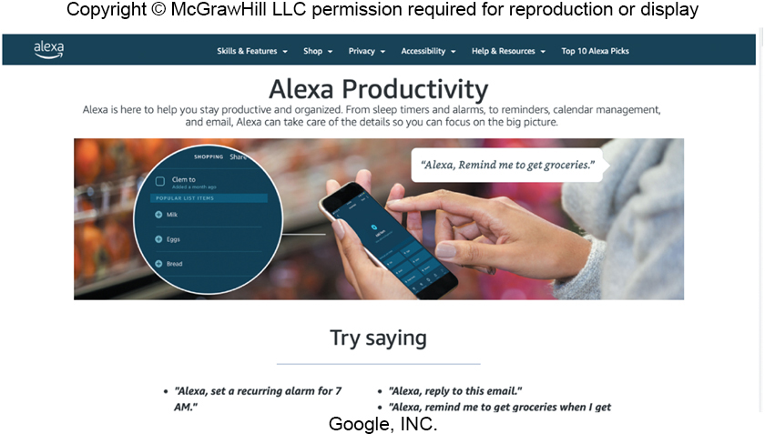
Making IT Work for you – Virtual Assistant
A utility that coordinates personal data across several applications, and provides a more intuitive way to interact with devices.
Google Inc; Apple; Microsoft Corporation; travelbetter.co.uk/Alamy Stock Photo
Notes:
Virtual Assistant – utility that coordinates personal data across several applications and provides a more intuitive way to interact with your computer, phone, or tablet.
Google Assistant
Apple’s Siri
Microsoft’s Cortana
Amazon’s Alexa

Slide 15
Utility Suites
Combine several programs into one package
Less expensive
Popular suites
Bitdefender.
Norton Utilities.
Notes:
Utility Suites (key term) combine several programs into one package
Suites provide a variety of utilities:
Programs to protect your system against viruses (key term)

Slide 16
Careers in IT
Computer Support Specialist or Technical Support Specialist or Help-Desk Technicians
Provide technical support to customers and other users.
Resolve common networking problems and use troubleshooting programs to diagnose problems.
Employers look for an advanced associate’s degree or bachelor’s degree.
Computer support specialist can expect to earn $43,000 − $68,000 annually.

Slide 17

A Look to the Future
Making Better Computers by Making Them More Human
Milles Studio/Shutterstock

Slide 18
Open Ended Questions
Describe system software. Discuss each of the four types of system programs.
Define operating systems. Describe the basic features and the three categories of operating systems.
What are mobile operating systems? Describe leading mobile operating systems.
What are desktop operating systems? Compare Windows, mac O S, Linux and Chrome O S. Discuss virtualization.
Discuss utilities. What are the most essential utilities? What is a utility suite?
Notes:
Have students turn to the end of Chapter 4 in their textbooks to view the same “Open-Ended” questions/statements

Slide 19
End of Main Content
© McGraw Hill LLC. All rights reserved. No reproduction or distribution without the prior written consent of McGraw Hill LLC.

